Slide 1
NVMe Specification Revision 1.4
Sreenithi N
Intern, SWT - CVF
20/04/2022

Slide 2
Agenda
Overview
Theory of Operation
Multipath IO and Namespace Sharing
Submission Queue and Completion Queue
Submission Queue Entry – Command Format
Physical Region Page (PRP) Entry and List

Slide 3
Introduction

Slide 4
Overview
The NVM Express interface allows host software to communicate with a non-volatile memory subsystem.
This interface is optimized for Enterprise and Client solid state drives.
It is attached as a register level interface to the PCI Express interface.
Three types of controllers with varying capabilities:
I/O controllers – access logical block
discovery controllers – access discovery log page*
administrative controllers – support commands that provide management capabilities

Slide 5
Theory of Operation
It includes support for parallel operation by supporting up to 64K I/O Queues with up to 64K outstanding commands per I/O Queue
Priority associated with each I/O Queue with well-defined arbitration mechanism
All information to complete a request is included in the 64B command itself, ensuring efficient small I/O operation
Support for multiple namespaces, multi-path I/O and namespace sharing, *MSI/MSI-X and interrupt aggregation
Robust error reporting and management capabilities
* Does not require uncacheable / MMIO register reads in the command submission or completion path
A maximum of one MMIO register write is necessary in the command submission path

Slide 6
Theory of Operation
An NVM Express controller is associated with a single PCI Function.
The capabilities and settings that apply to the entire controller are indicated in the Controller Capabilities (CAP) register and the Identify Controller data structure.
Identify Namespace data structure indicates capabilities and settings that are specific to a particular namespace.
The NVMe interface is based on a paired Submission and Completion Queue mechanism.
An Admin Submission and associated Completion Queue exist for the purpose of controller management and control.
The number of command queues created is based on the system configuration and anticipated workload.
There is always a 1:1 mapping between the Admin Submission Queue and Admin Completion Queue.

Slide 7
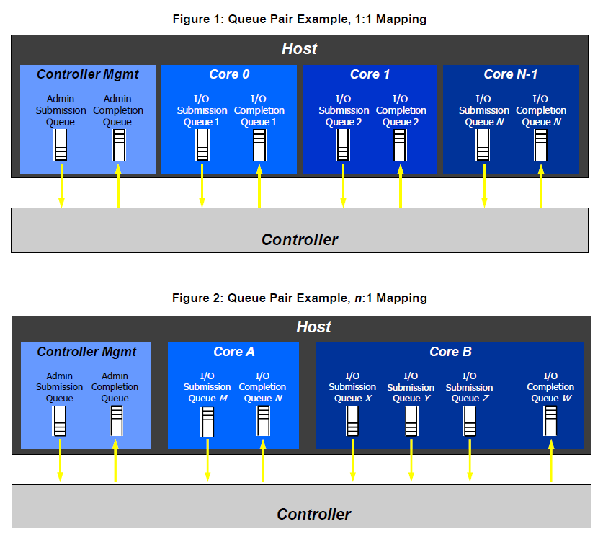
Theory of Operation
A Submission Queue (SQ) is a circular buffer with a fixed slot size that the host software uses to submit commands for execution by the controller.
Each Submission Queue entry is a command. Commands are 64 bytes in size.
The physical memory locations in memory to use for data transfers are specified using Physical Region Page (PRP) entries or Scatter Gather Lists.
A Completion Queue (CQ) is a circular buffer with a fixed slot size used to post status for completed commands.
A completed command is uniquely identified by a combination of the associated SQ identifier and command identifier that is assigned by host software.

Slide 8
Theory of Operation

Slide 9
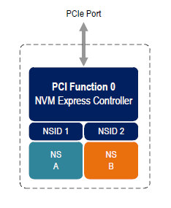
Namespace
A namespace is a collection of logical blocks.
The number of namespaces supported is indicated in the Identify Controller data structure.
Namespace size – Number of logical blocks available
Namespace capacity – Maximum number of logical blocks allocated at any time (thin provisioning)
Namespace utilization – Number of logical blocks currently allocated
Size >= Capacity >= Utilization

Slide 10
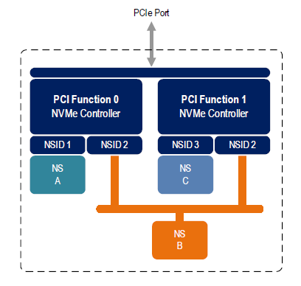
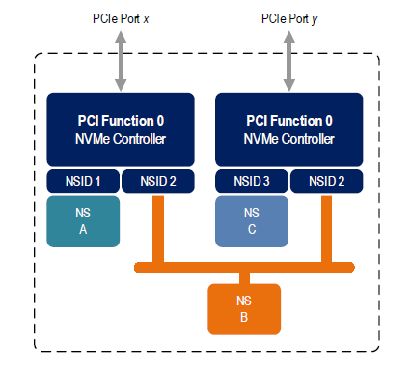
Multi-Path I/O and Namespace Sharing
*Concurrent access to a shared namespace by two or more hosts requires some form of coordination between hosts. The procedure used to coordinate these hosts is outside the scope of this specification.

Slide 11
Data Structures

Slide 12
Submission Queue (SQ) & Completion Queue (CQ)
CQ head doorbell and SQ tail doorbell registers are used by host
Submitter uses current tail entry pointer to identify next open queue entry space
Consumer uses current head entry pointer to identify next entry to be pulled off
CQ is always created before SQ
SQ is always deleted before CQ

Slide 13
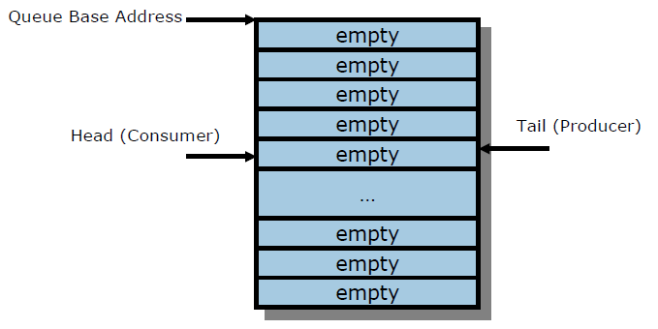
Empty Queue
Head Pointer = Tail Pointer

Slide 14
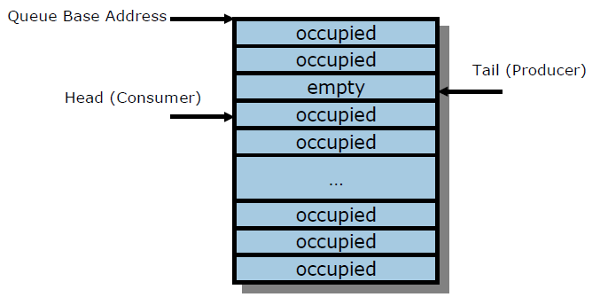
Full Queue
Head Pointer = Tail Pointer + 1
The number of entries in a queue when full is one less than the queue size
Queue wrap conditions shall be considered while determining queue full

Slide 15
Queue Size
Indicated in 16-bit field which indicates number of slots in the queue
Minimum size – 2 slots
Maximum size (limited by size specified in CAP.MQES field)
IO SQ / CQ – 64K
Admin Queue – 4K
Queue Identifier
16-bit ID value assigned when queue is created
Queue Priority
Used when weighted round robin with urgent priority class arbitration mechanism is supported
Queue priority service class - Urgent, High, Medium, or Low
5/18/2022
15
5/18/2022
15

Slide 16
Submission Queue Entry – Command Format
Each command is 64 bytes
Command Dword 0, Namespace Identifier, Metadata Pointer, PRP Entry 1, PRP Entry 2 - common definitions for all Admin commands and NVM commands
Metadata Pointer, PRP Entry 1, PRP Entry 2, and Metadata SGL Segment Pointer are not used by all commands
SGLs are not used for Admin commands (over PCIe implementation)

Slide 17
Submission Queue Entry – Command Format
Command DWORD 0
31 : 16 | 15 : 14 | 13 : 10 | 09 : 08 | 07 : 00
Opcode
FUSE
Reserved
PSDT
CID

Slide 18
Submission Queue Entry – Command Format
Submission Queue Entry
63 : 60 | 59 : 56 | 55 : 52 | 51 : 48 | 47 : 44 | 43 : 40 | 39 : 24 | 23 : 16 | 15 : 08 | 07 : 04 | 03 : 00
Command Dword 0 (CDW0)
NSID
Reserved
MPTR
DPTR
Command Dword 10 (CDW10)
Command Dword 11 (CDW11)
Command Dword 12 (CDW12)
Command Dword 13 (CDW13)
Command Dword 14 (CDW14)
Command Dword 15 (CDW15)

Slide 19

PRP Entry
It is a pointer to a physical memory page
Used for data transfer between controller and host memory
PRP entries are fixed size
Except first PRP entry, all others must be page-aligned (memory offset of 0h)

Slide 20
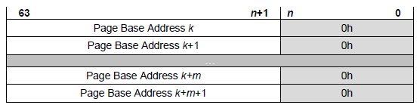
PRP List
Set of PRP entries in a single page of contiguous memory
Describes additional PRP entries that could not be described within the command itself
Last PRP entry before the end of the memory page shall be a pointer to the next PRP List

Slide 21
PRP List
PRP Entry 1
PRP Entry 2

Slide 22
PRP List
PRP Entry 1
PRP Entry 2

Slide 23
Controller Registers

Slide 24
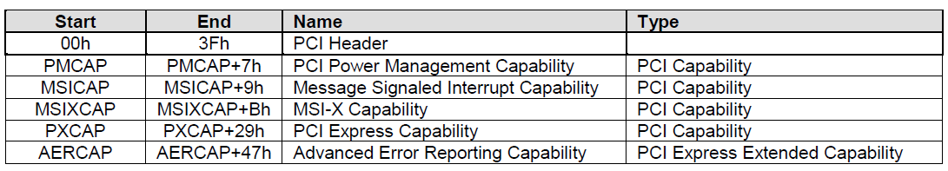
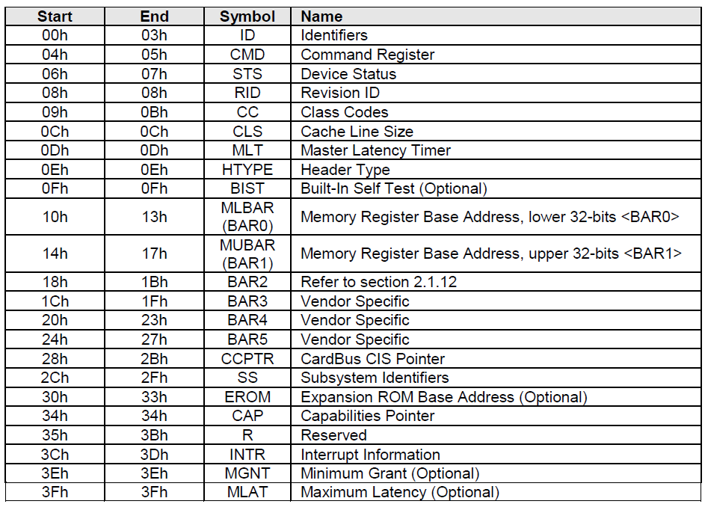
PCIe Registers

